Slide 1

Scripting for Larger Circuits
Roger C. Dugan
Sr. Technical Executive, EPRI
Jacobs Hall, UCSD
Dec 14-15, 2010

Slide 2
Organizing Your Main Screen
OpenDSS.exe saves all windows on the main screen
  They appear where you left them when you shut down
  The next time you start up, you can resume your work
Values are saved in a file (OpenDSS.ini)
  in the OpenDSS.exe folder
    Note: You can update the program simply by copying in new exe and dll files.
  Do not overwrite the “.ini” file if you want to preserve your workspace
    However, if the .ini file gets corrupted, you may simply delete it.

Slide 3
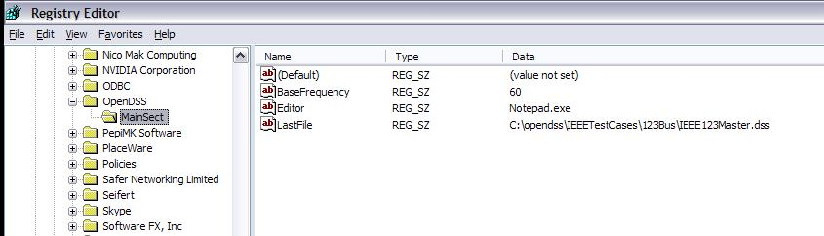
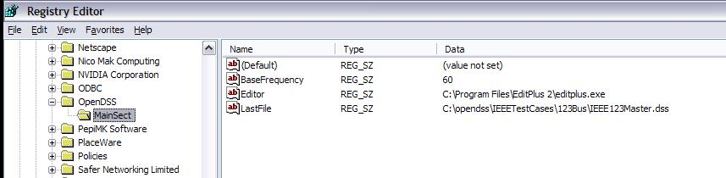
OpenDSS Registry Entries
Certain persistent values are saved to the Windows Registry upon exiting the program
Default Editor Setting
After Redefining

Slide 4
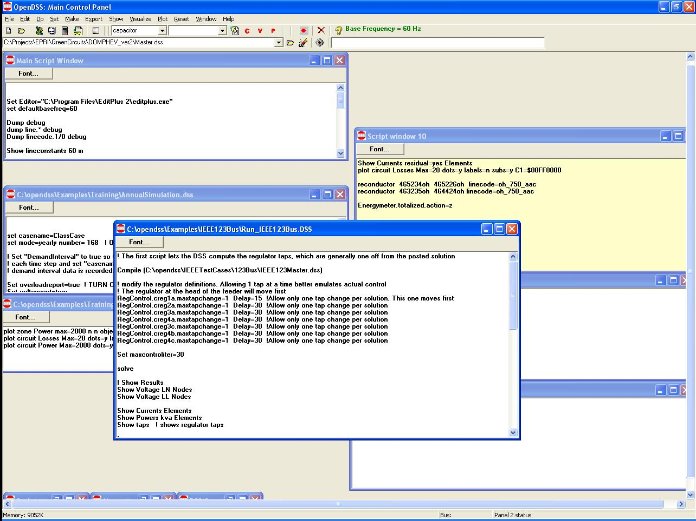
Organizing Your Main Screen
Main Script Window never goes away. Put some frequently-used commands here.
Annual Simulation Script
Misc. Scripts
Plotting Scripts
Project Run window

Slide 5
A Common Sense Structuring of Script Files
Run_The_Master.DSS
“Compile” the Master file from here
Master.DSS
LineCodes.DSS
WireData.DSS
LineGeometry.DSS
Libraries
Put a “Clear” in here
Spectrum.DSS
LoadShape.DSS
Transformers.DSS
Lines.DSS
Circuit
Definition
Make a separate folder for each circuit
Loads.DSS
Etc.

Slide 6
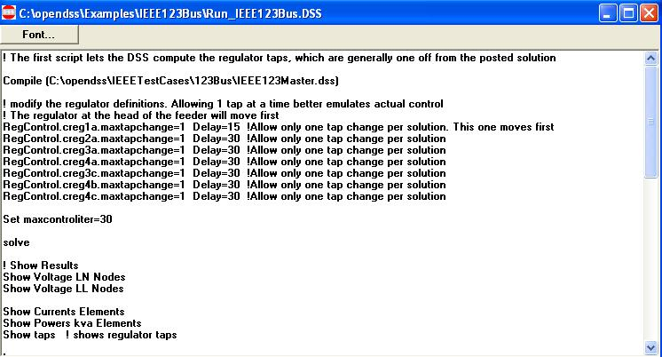
Organizing Run Scripts
Compiles the Circuit Description
Override Some Property Settings
and/or
Define Some Additional Circuit Element
Change an option
Solve Snapshot Power Flow
Selected Results Display

Slide 7
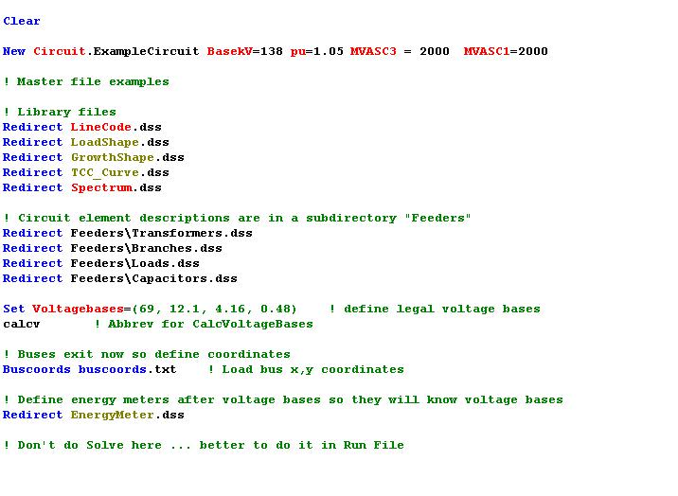
Organizing Master File
So Compile Doesn’t Fail
General Library Data
Circuit Elements for this Model
Let OpenDSS Define the Voltage Bases

Slide 8
Example:
IEEE 8500-Node
Test Feeder

Slide 9
Main Part of 8500-Node Run File
Compile (Master-unbal.dss) ! unbalanced load master
New Energymeter.m1 Line.ln5815900-1 1 ! Put an Energymeter at the head of the feeder
Set Maxiterations=20 ! Sometimes the solution takes more than the default 15 iterations
Solve

Slide 10
The Master File
Clear
New Circuit.IEEE8500u
! Make the source stiff with small impedance
~ pu=1.05 r1=0 x1=0.001 r0=0 x0=0.001
Redirect LineCodes2.dss
Redirect Triplex_Linecodes.dss
Redirect Lines.dss
Redirect Transformers.dss
Redirect LoadXfmrs.dss ! Load Transformers
Redirect Triplex_Lines.dss
Redirect UnbalancedLoads.dss
Redirect Capacitors.dss
Redirect CapControls.dss
Redirect Regulators.dss
! Let DSS estimate the voltage bases
Set voltagebases=[115, 12.47, 0.48, 0.208]
Calcvoltagebases ! This also establishes the bus list
! Load in bus coordintes now that bus list is established
Buscoords Buscoords.dss

Slide 11
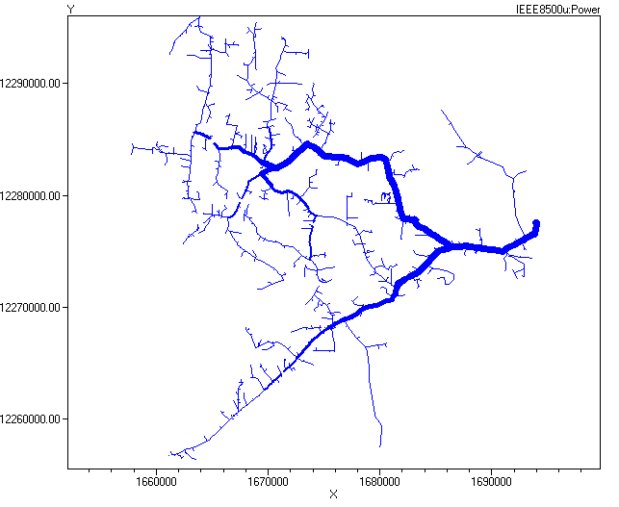
Power Flow Solution Plot

Slide 12
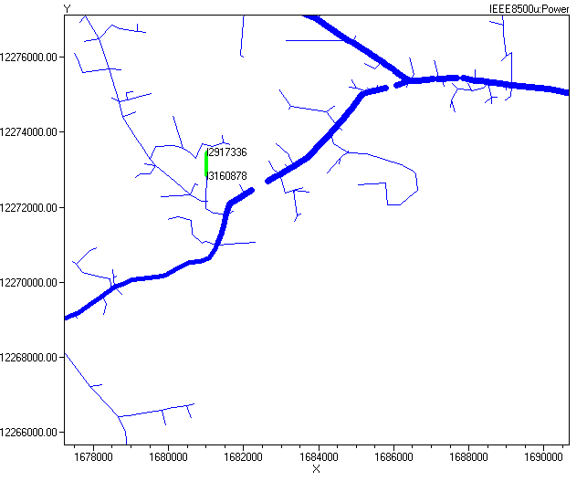
Selecting a Branch from the Plot (Zoomed)

Slide 13
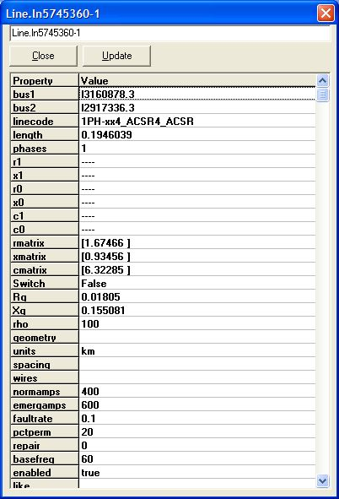
Right-click and select Properties …

Slide 14
Demo …

Slide 15
Together…Shaping the Future of Electricity

